Slide 2
Digital Forensics Lecture-22
By- Dr.subhranil Das
Assistant Professor
School of computer Science

Slide 3

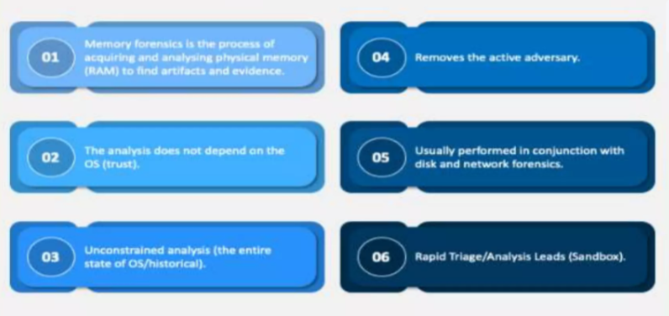
Memory Forensics

Slide 4
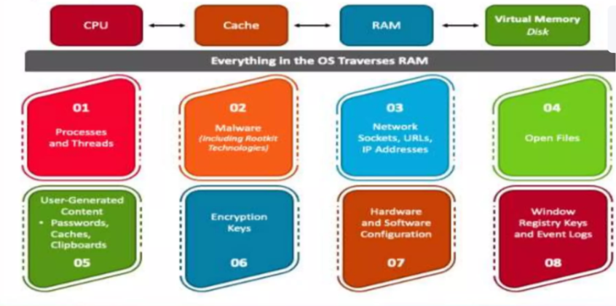
Why Memory Forensics?

Slide 5
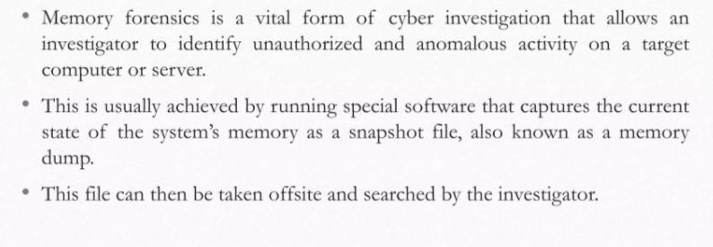
What is Memory Forensics?

Slide 6
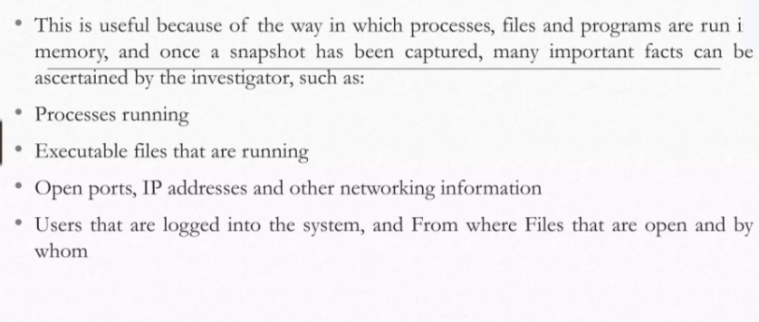
What is Memory Forensics?

Slide 7
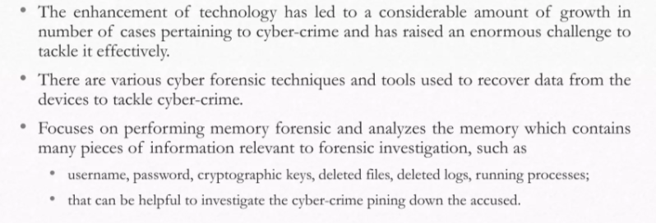
Motivation

Slide 8
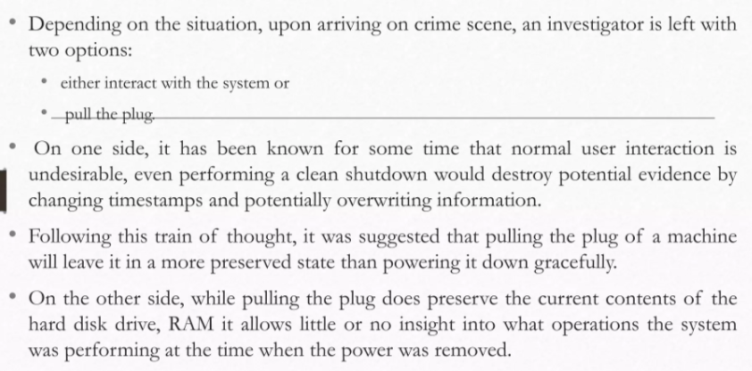
Motivation

Slide 9
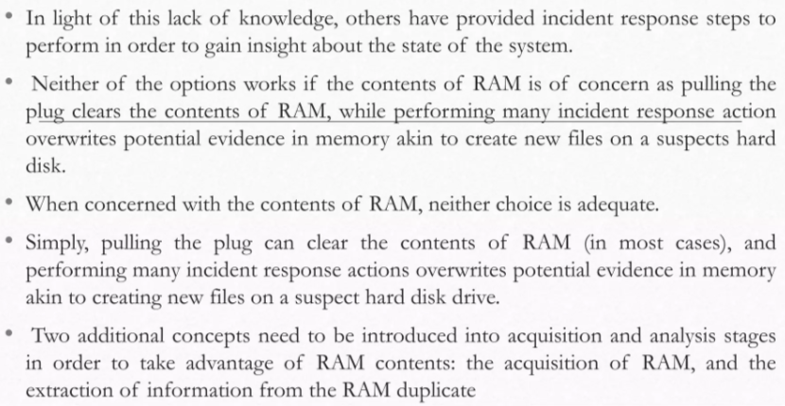
Introduction

Slide 10
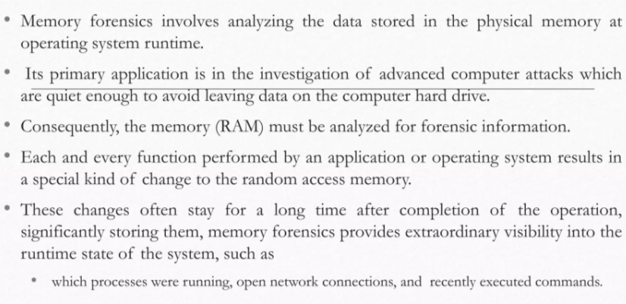
Introduction (Contd.)

Slide 11
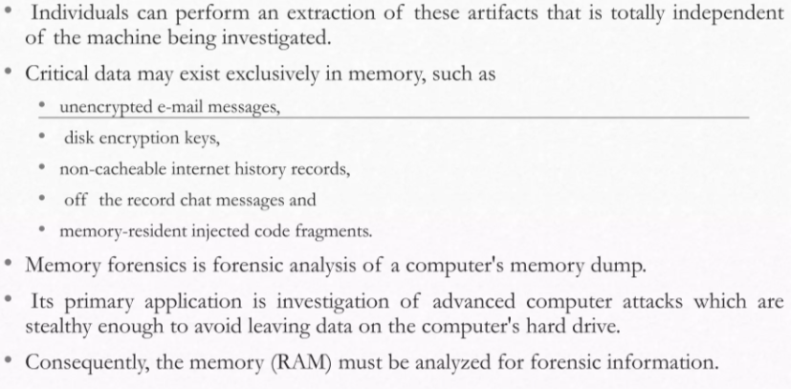
Data exists in the memory

Slide 12
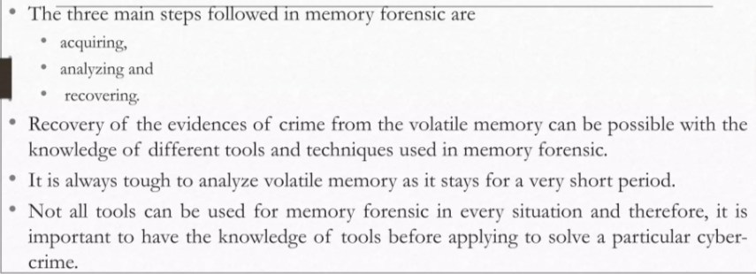
Steps in the memory forensics

Slide 13
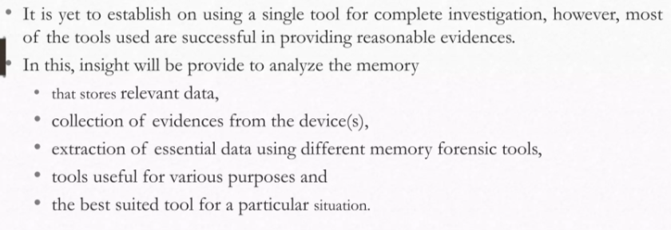
Steps in the memory forensics

Slide 14
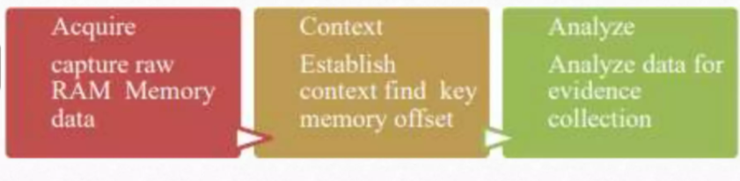
Acquisition and Analysis of Memory

Slide 15
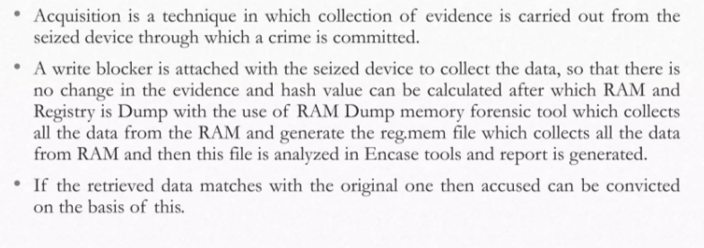
Acquisition and Analysis of Memory

Slide 16
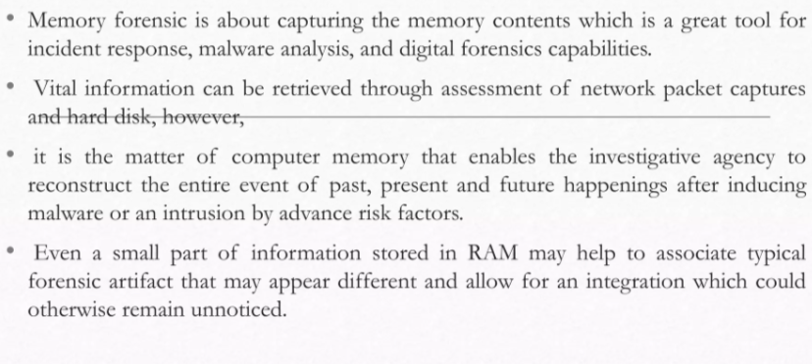
Acquisition and Analysis of Memory

Slide 17
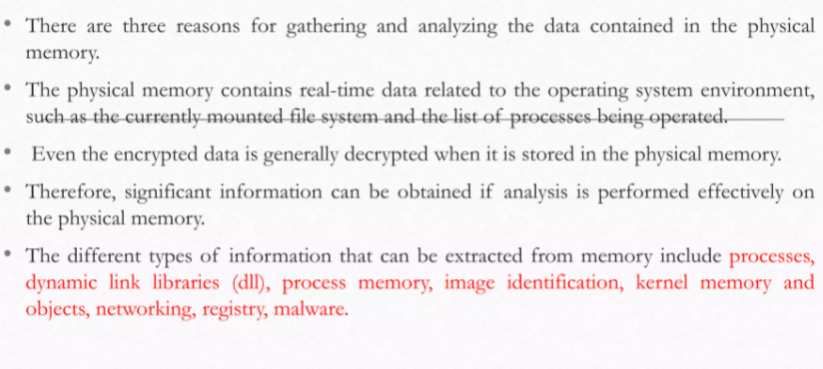
Acquisition and Analysis of Memory

Slide 18
Next Lecture
Memory Analysis
.

